Slide 1

Scrum Model of Working Agile Framework for Effective Team Collaboration
Presented by MD Moniruzzaman Sajjadur Rahman Minhazul Islam

Slide 2


Agenda
1. Introduction to Scrum
2. Core Principles and Framework
3. Scrum Roles and Events
4. Artifacts and Tools
5. Benefits and Challenges
6. Scrum vs Traditional Models
7. Real-World Applications
8. Best Practices & Scaling
9. Summary and Q&A

Slide 3
Introduction
Agile methodology overview
Why Scrum?
Adaptive planning and iterative progress
“Scrum is not about doing more work faster. It’s about being agile and delivering value quickly.”

Slide 4
What is Scrum?
Scrum is a lightweight Agile framework for managing complex work.
Focuses on iterative progress through Sprints.
Promotes teamwork, accountability, and continuous improvement.

Slide 5
History and Origin
Created by Ken Schwaber & Jeff Sutherland
Early 1990s
First Scrum Guide in 2010

Slide 6
Core Principles of Scrum
Transparency
Inspection
Adaptation
“Transparency, inspection, and adaptation – the heartbeat of Scrum.” – Scrum Alliance

Slide 7
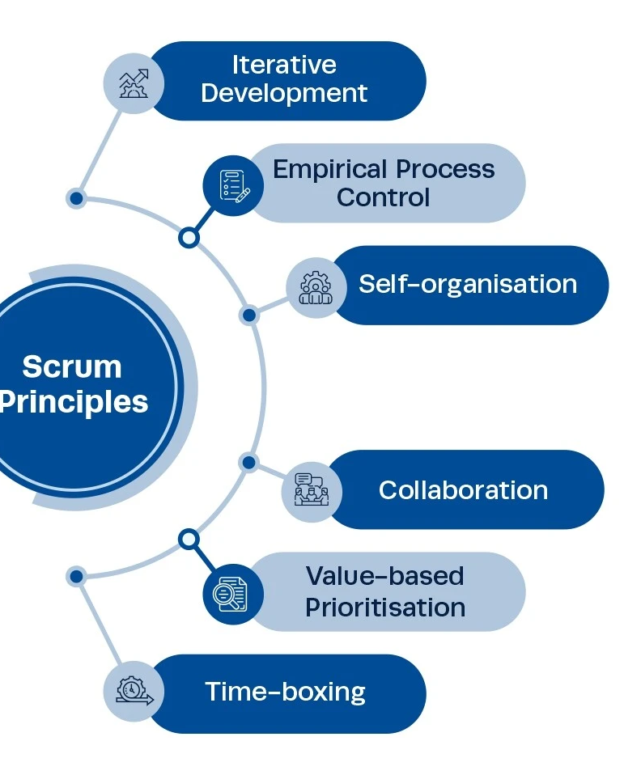
Scrum Principles

Slide 8
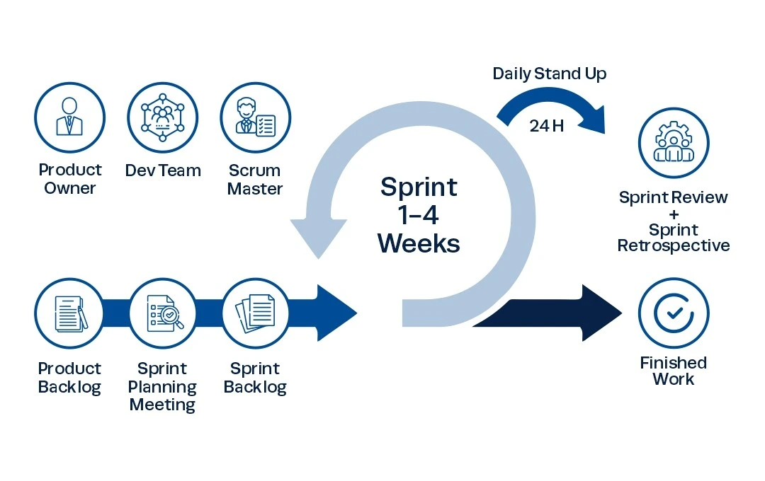
Scrum Framework Overview
Roles
Events
Artifacts

Slide 9
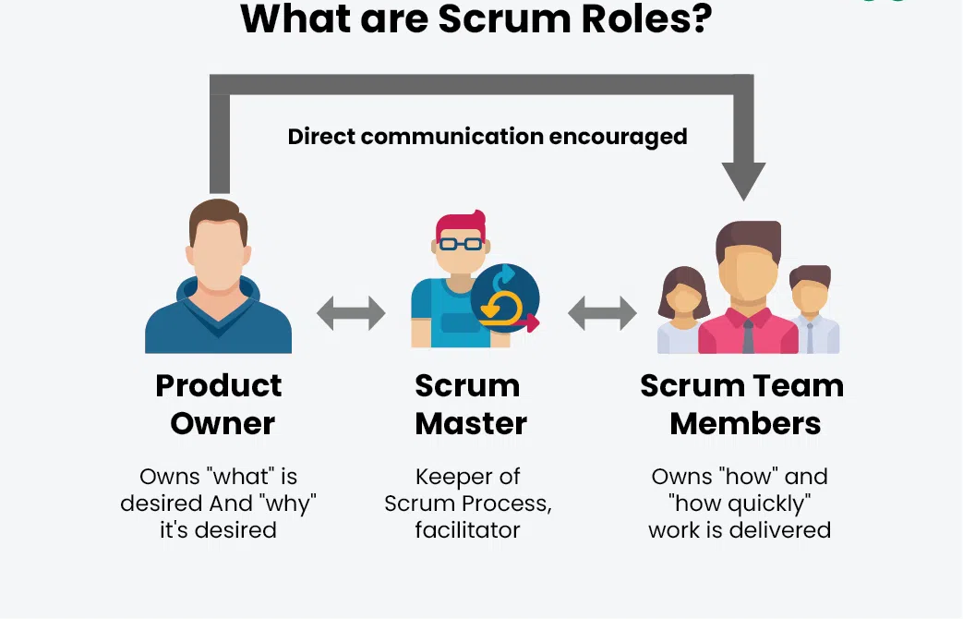
Scrum Roles
Product Owner
Scrum Master
Scrum Team member

Slide 10
Scrum Roles – Product Owner
Represents customer
Manages backlog
Sets vision and priorities
“The Product Owner is the value maximizer.” – Scrum Guide

Slide 11
Scrum Roles – Scrum Master & Development Team
Scrum Master: facilitator, removes blockers
Development Team: cross-functional, self-organizing

Slide 12
Scrum Framework Overview
Roles
Events
Artifacts

Slide 13
Scrum Events – Sprint
Fixed-length iteration (1-4 weeks)
Work completed and reviewed
Goal stays constant
“A Sprint is a heartbeat of Scrum.” – Ken Schwaber

Slide 14
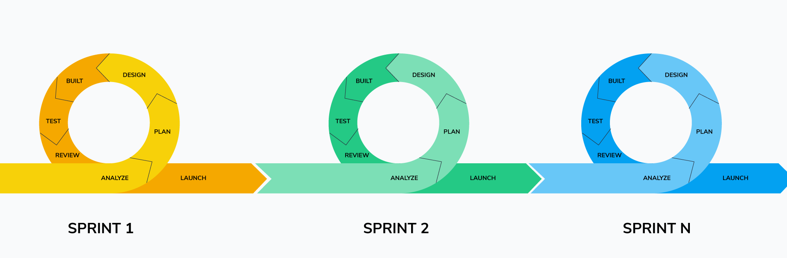
Scrum Events – Sprint
“A Sprint is a heartbeat of Scrum.” – Ken Schwaber

Slide 15
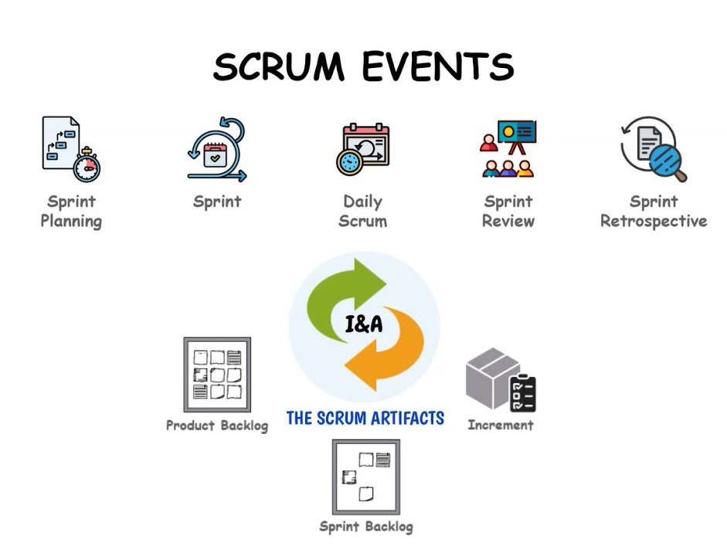
Scrum Events – Planning, Review, Retrospective
Sprint Planning
Sprint Review
Sprint Retrospective

Slide 16
Daily Scrum
15-minute stand-up
1
Sync team progress
2
Identify blockers
3

Slide 17
Scrum Framework Overview
Roles
Events
Artifacts

Slide 18
Scrum Artifacts – Product Backlog
List of potential product work
Managed by Product Owner
Continuously refined

Slide 19
Scrum Artifacts – Sprint Backlog & Increment
Sprint Backlog: tasks for Sprint
Increment: completed, usable work

Slide 20
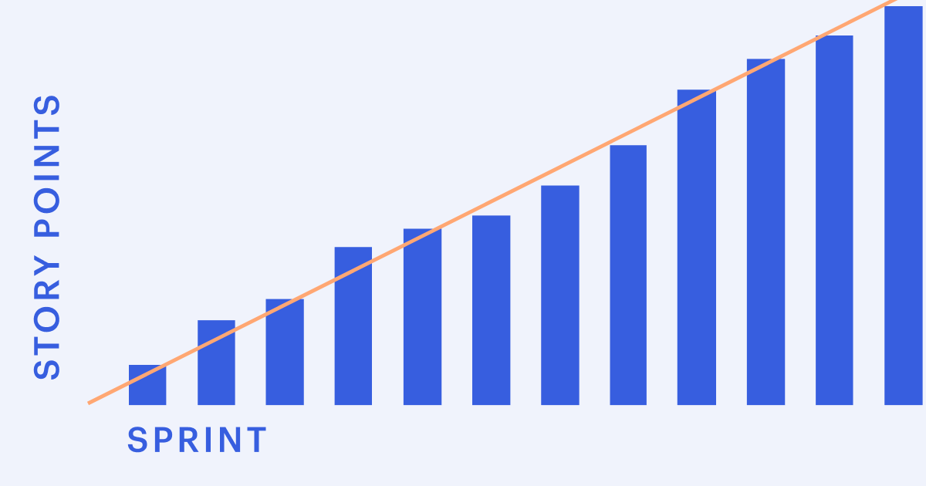
Scrum Board & Burn-down Chart
Tracks task status
Shows remaining work
Visual progress tools

Slide 21
The Scrum Workflow
Roles, events, artifacts in a cycle
Continuous improvement

Slide 22
Benefits of Scrum
Faster delivery
Higher quality
Team collaboration
Agile response to change
“Teamwork makes the dream work.” – John C. Maxwell

Slide 23
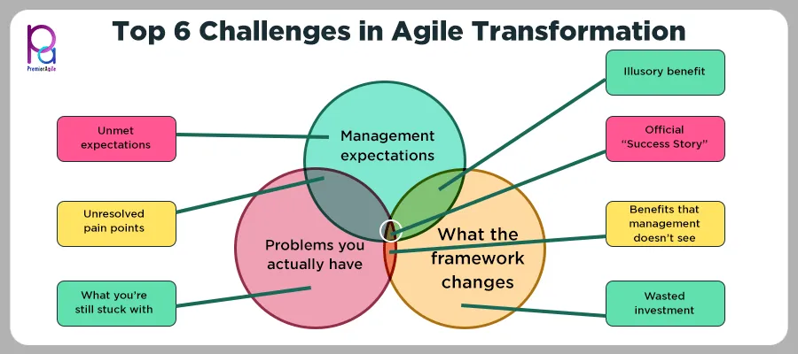
Challenges in Scrum
Misunderstood roles
Resistance to change
Scope creep
Team immaturity
“Scrum doesn’t solve problems, it makes them visible.” – Ken Schwaber

Slide 24
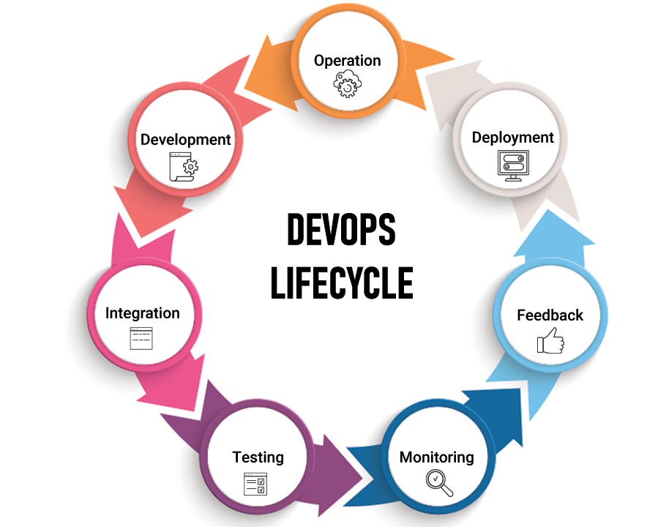
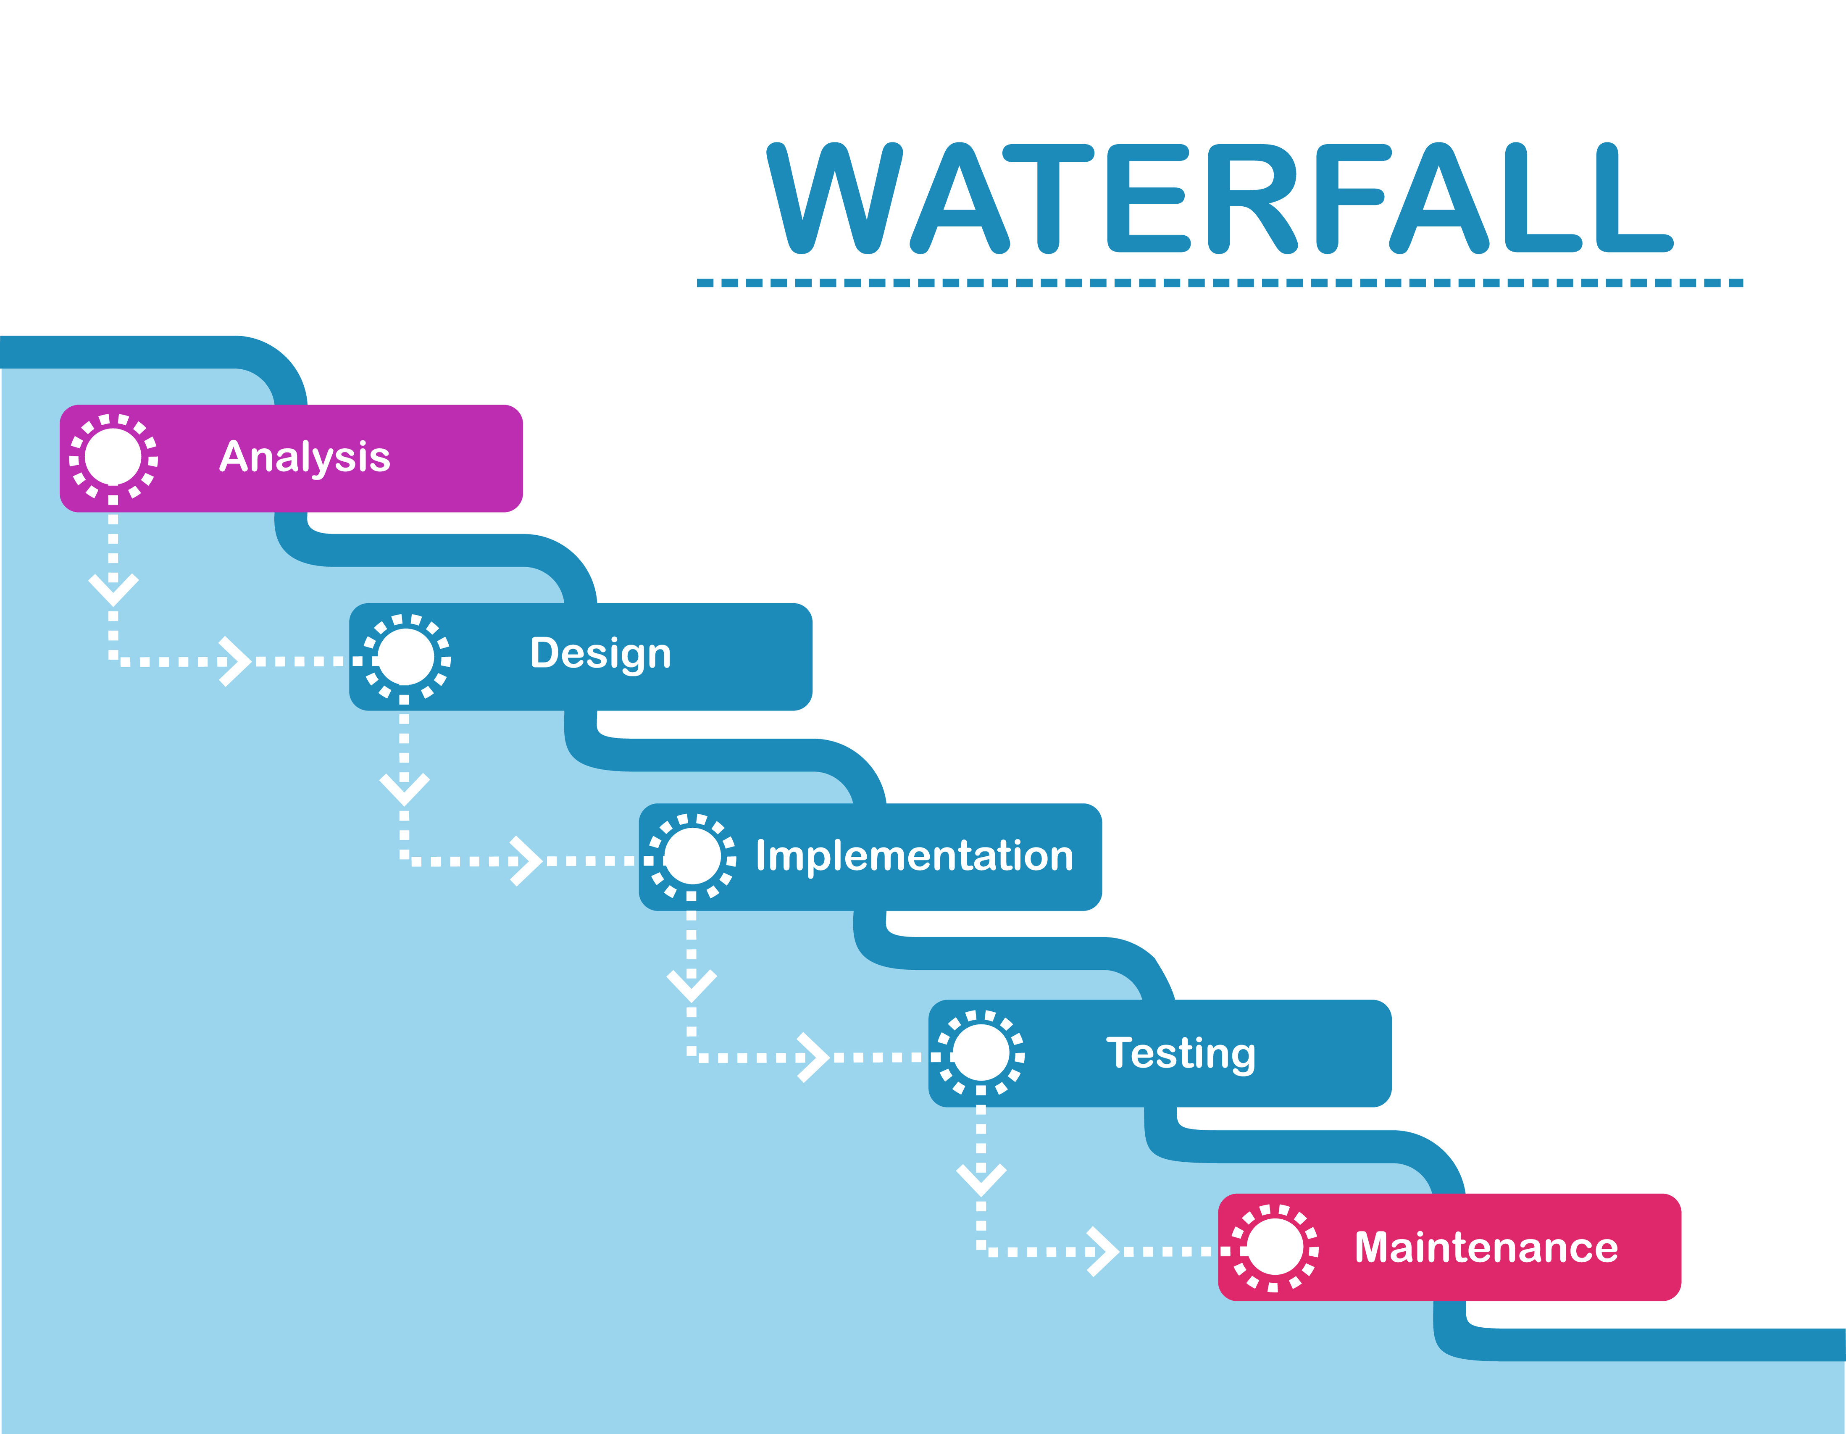
Other Traditional Models
Waterfall
DevOps

Slide 25
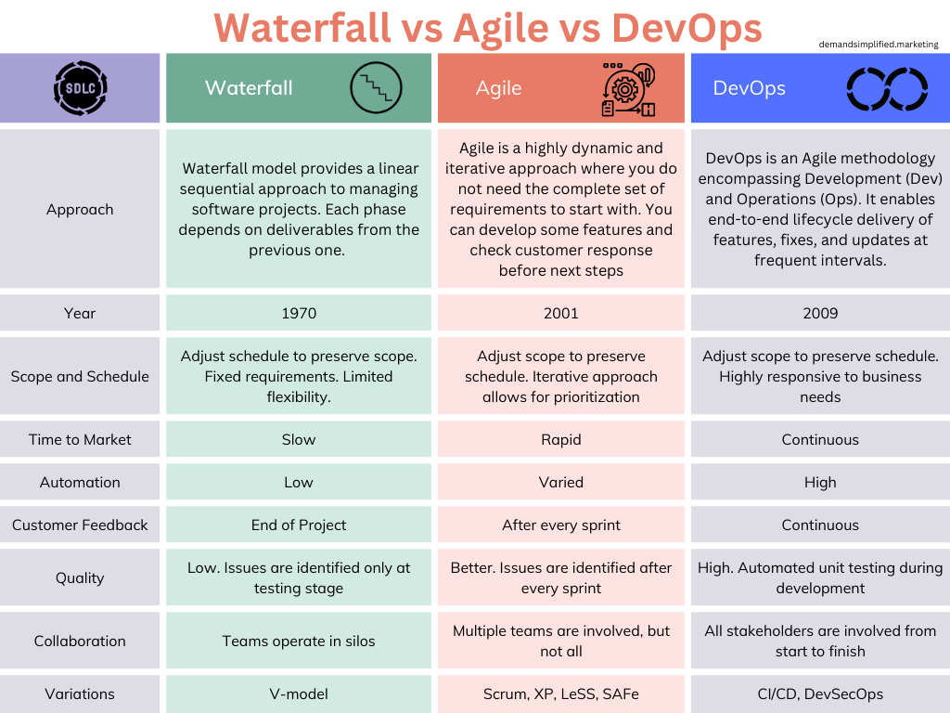
Scrum vs Traditional Models

Slide 26
Real-World Applications – Software
Used by BBC, Google, Spotify
Improves product development

Slide 27



Scrum in Action – Case Study
Spotify: Uses Squad-based structure aligned with Scrum principles.
Google: Applies Scrum in development of AI and mobile apps.
BBC: Adopted Scrum for rapid development and product delivery.

Slide 28
Real-World Applications – Other Industries
Marketing, Education, Product Design
Adaptable beyond software

Slide 29




Scrum Tools
Jira
Trello
Azure DevOps
ClickUp

Slide 30
Common Myths About Scrum
Scrum is unstructured (False)
No documentation needed (False)
No planning (False)

Slide 31
Best Practices
Daily collaboration
Refine backlog
Effective retrospectives
“None of us is as smart as all of us.” – Ken Blanchard

Slide 32
Scaling Scrum
SAFe, LeSS, Scrum@Scale
Coordination across teams
Enterprise agility

Slide 33
Scaling Scrum
Frameworks for large-scale Scrum implementation:
- SAFe (Scaled Agile Framework)
- LeSS (La
rge-Scale Scrum)
- Nexus (by Scrum.org)
Each supports multiple teams working on the same product.

Slide 34
Scrum Best Practices
• Define clear roles and responsibilities.
• Maintain a well-groomed Product Backlog.
• Ensure a shared understanding of 'Done'.
• Timebox all Scrum events strictly.
• Promote open communication and collaboration.

Slide 35
Summary and Key Takeaways
Scrum = Collaboration + Agility
Structured, iterative process
Delivers value incrementally
“Great things in business are never done by one person.” – Steve Jobs

Slide 36
References
Books & Quotes:
Schwaber, K. & Sutherland, J. (2020). The Scrum Guide. Scrum.org
Maxwell, J.C. (2002). Teamwork Makes the Dream Work
Blanchard, K. (1999). The One Minute Manager Builds High Performing Teams
Isaacson, W. (2011). Steve Jobs. Simon & Schuster
Image Sources:
Waterfall vs Agile vs DevOps: DemandSimplified.Marketing
Agile Transformation Challenges: PremierAgile.com
Velocity Chart (Story Points): Atlassian
Scrum Events & Artifacts: YouTube (Agile Explainers)
Sprint Lifecycle: VisualParadigm
Scrum Roles: GeeksForGeeks
Scrum Principles: Tech Blog / VisualParadigm
Scrum Framework: Scrum.org / Medium

Slide 37
Thank You & Q&A
We appreciate your attention.
Let’s open the floor for your questions and discussion.

